Slide 1
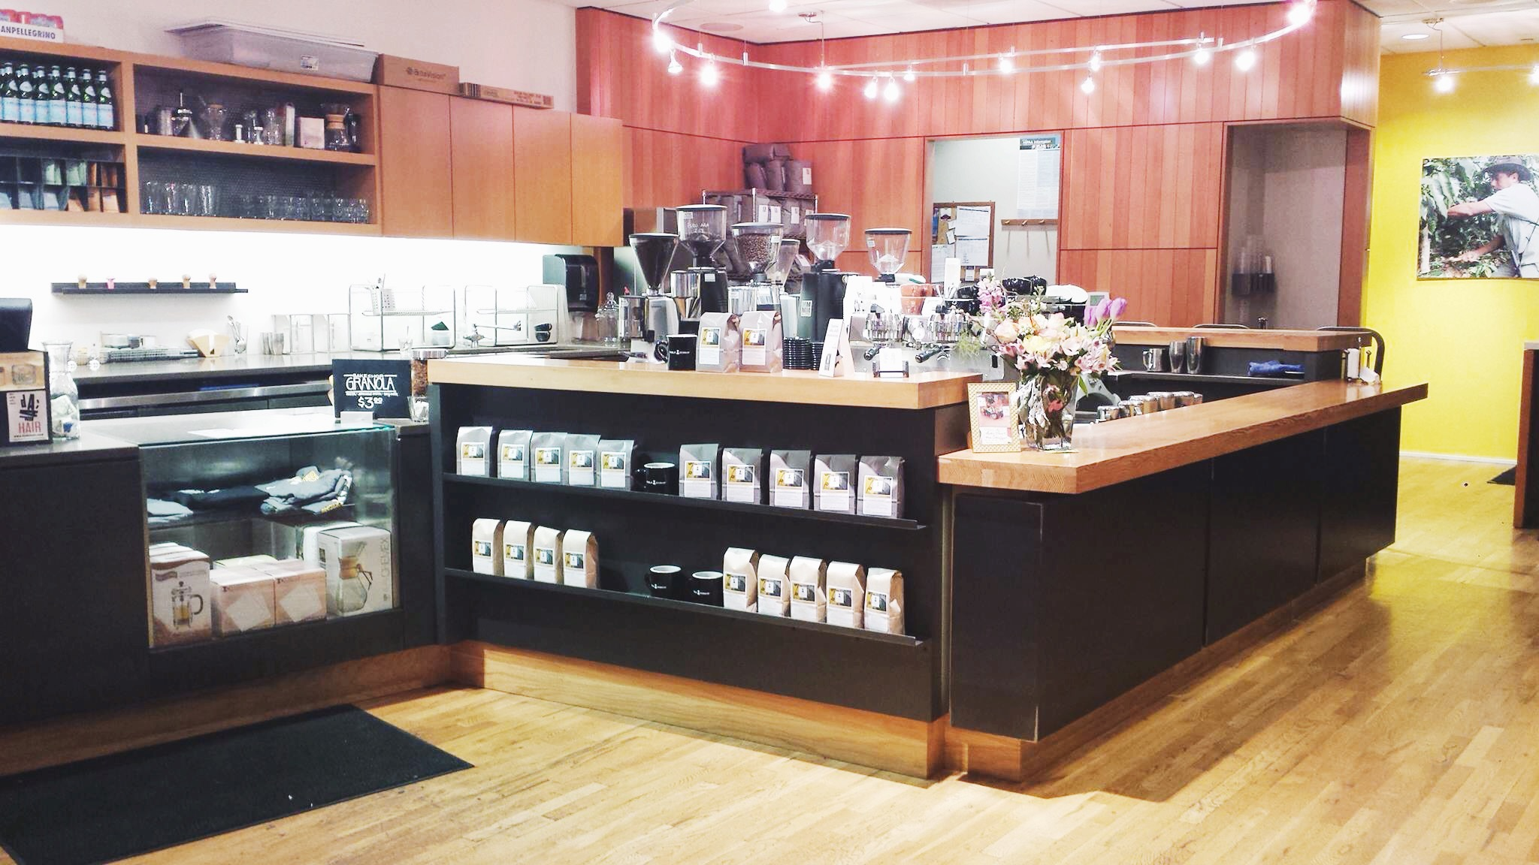
USING LOCAL BUSINESSES TO FIND THE NEXT HOT NEIGHBORHOODS

Slide 2
THE STARBUCKS EFFECT
The rise of upscale neighborhoods is often associated with incoming small retail businesses such as small eateries, cafes, and other upscale shops. Some have termed attributed “the Starbucks effect” to, among other things, the gentrification and establishment of new desirable neighborhoods, which lead to higher home values and rents in those areas. But what types of businesses are these specifically?
Many home buyers and renters looking for a place to settle down often look for indicators to find the next hot neighborhoods where they live.
The Problem:
What are the types of stores which correlate highly with rising home values and rents? Using these various store types, find a regression model which may be appropriate in predicting their impact.

Slide 3
USING DATA TO TEST A HYPOTHESIS
Information about individual and categories of retail businesses can be compiled from Yelp’s API for a given local area. This can be combined with trended home pricing data from a variety of sources at this zip-code level, including Zillow.
The Hypothesis:
Cafes like Starbucks are highly correlated with nearby home values. Meanwhile, specialty grocers such as Trader Joe’s and Whole Foods also exhibit positive correlation. Meanwhile, the existence of big box department stores such as Macy’s and Walmart have little affect on local real estate markets.
Bonus:
Include research on geolocation and the reach of these types of business.

Slide 4
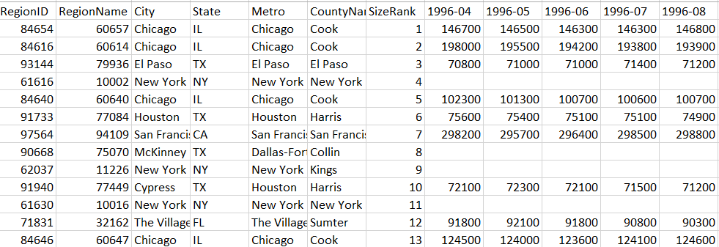
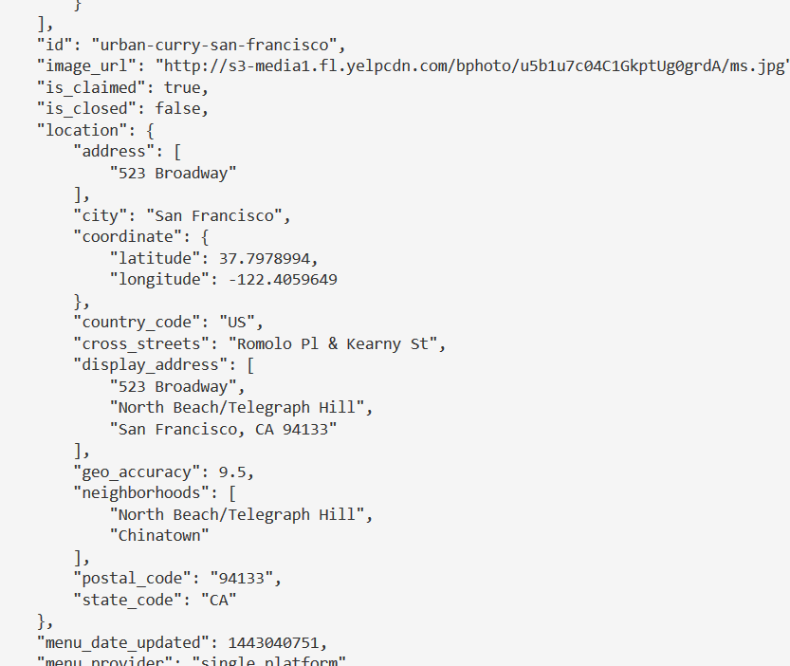
SAMPLE DATA

Slide 5
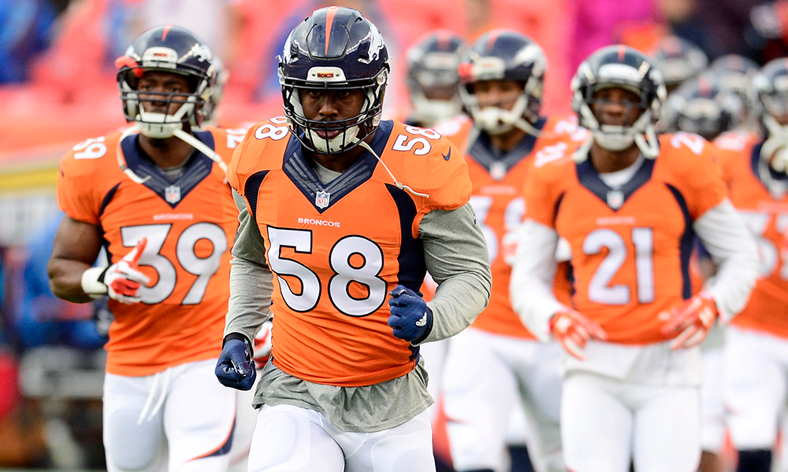
USING NFL PLAYER RANKINGS TO PREDICT TEAM OUTCOMES

Slide 6
DOES “D” WIN CHAMPIONSHIPS?
Stars of headline NFL teams usually create the hype and storylines, and they generally earn a disproportionate amount of team’s salary. But how much do they contribute to the overall success of a team.
Team owners and talent evaluators are often faced with task of which players to draft, sign, and retain; while fans and speculators often how their sides will eventually fare, given the players on each side.
The Problem:
How well do individual player performance rankings affect the actual performance of a team? Are certain positions and/or combinations of positions more important than others?

Slide 7
USING DATA TO TEST A HYPOTHESIS
Human analysts review tapes to evaluate the individual performance of in-game performance, considering more than just “basic stats.” Game scenarios are also factored. This data (available for small fees) can be used to compare against the overall win/loss success as well as other target metrics
The Hypothesis:
Test two main hypotheses: 1) H0 where individual player performance is not important and 2) H0 where all positions contribute equally.
Further explore combinations of positions, importance of offensive versus defensive performance

Slide 8
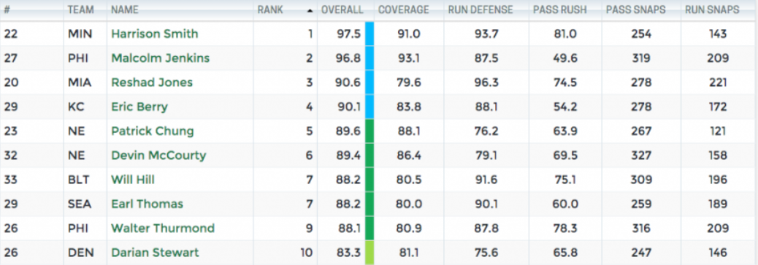
SAMPLE DATA

Slide 9

CHOOSING COLORS FROM
ACTIVEWEAR IMAGERY

Slide 10
COLORS IN ACTIVEWEAR IMAGERY
Activewear apparel for men and women can be found in almost any set of colors imaginable. While the plethora of options are options for those who enjoy spending the time to piece together a wardrobe. But for the individual who just wants to blend in while keeping up with current trends, how does one figure out what really are the popular hottest colors of the season (at least in the minds of the fashion stylists?)
At any given time, current trends in fashion often steer online retailers towards an emphasis on marketing particular color combinations. One way retail merchandisers can to do this is through the specific selection of colors available for each apparel item. Another way is through the use of product photo and other artistic imagery online.
The Problem:
So what are the current “in” colors in activewear? Are there any common color combinations? And are there specific types of products these colors apply to?

Slide 11
USING DATA TO TEST A HYPOTHESIS
Product and other webpage imagery can be scraped from major online retailers using Python’s BeautifulSoup and other packages. Individual pixels can be extracted from these images and grouped to distill a manageable set of primary and secondary colors.
The Hypothesis:
Black/white/greyscale colors are safe, ubiquitous colors and common colors for men and women in all types of products. Blacks and other dark shades, are safer bets for bottoms. Meanwhile, bold colors are also common, but they are typically found in off-shade varieties of primary colors, and frequently as a secondary/trim color on many products.

Slide 12
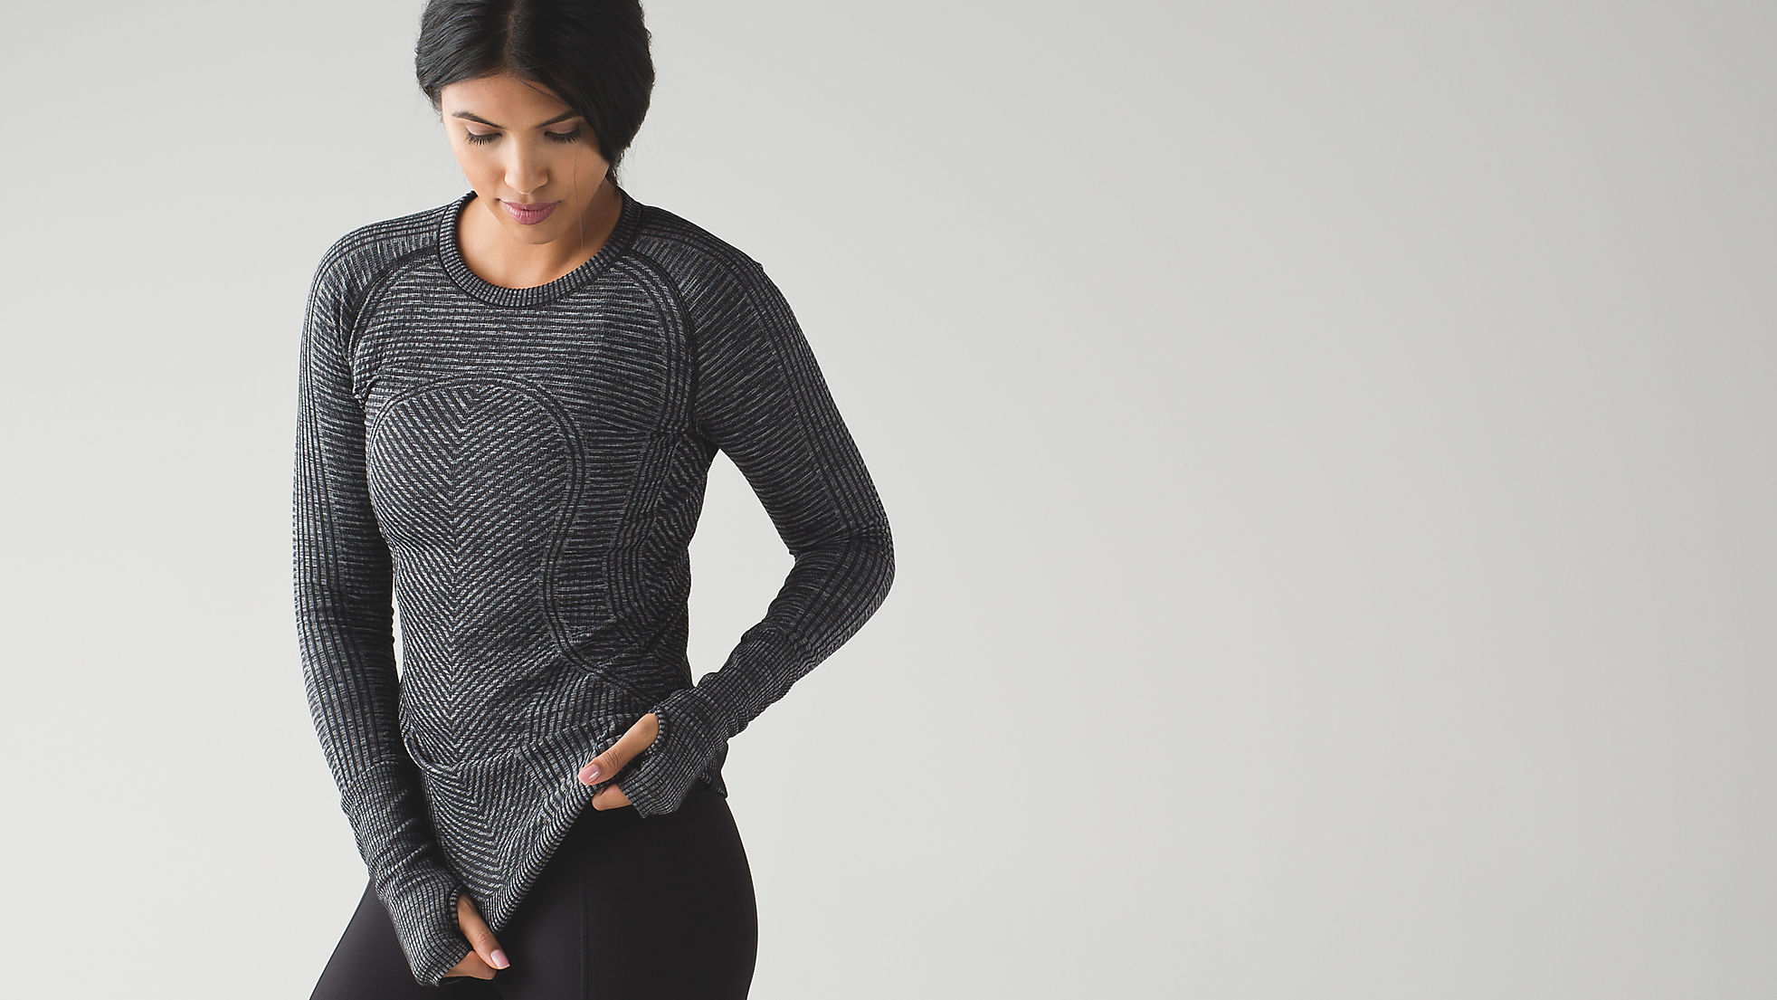
USING PRODUCT FEATURES TO MEASURE CONSUMER SATISFACTION

Slide 13
PRODUCT FEATURES IN ACTIVEWEAR
Consumers today have a seemingly endless set of choices in performance apparel. Often decisions come down to some fine and subtle differences in features which are described by the manufacturer. In apparel, these descriptions are frequently only readily found on the retailer’s product detail pages. But what types of features are important to consumers?
Occasionally, buyers will leave online feedback and ratings for products which can help with understanding consumer preference.
The Problem:
What are the types of materials and features in performance apparel which resonates well with consumers (i.e. moisture-wicking, pockets, thumbholes etc.)? In which products are they most valuable (i.e mens versus womens, top versus bottoms, etc.)

Slide 14
USING DATA TO TEST A HYPOTHESIS
Product descriptions and customer reviews of individual products can be scraped using Python’s BeautifulSoup and other packages. Keywords from text can then be parsed and compiled into categories to evaluate whether any specific product features correlate with positive reviews. Using the same technique, feedback which pertains to poor fit, shipping issues, or other unrelated aspects of the purchase can be removed for the purpose of this analysis.
The Hypothesis:
There may be certain product features which consistently aid in high product reviews. These features may extend to certain categories of products only.

